Slide 1









DeX-Auction
By:- Ishan Shukla
Notes:
https://unsplash.com/photos/AXu2aZ3YgP8

Slide 2

Previous
Recap

Slide 3

Decentralized WEB 3.0
Web 3.0 represents the latest generation of internet applications and services powered by distributed ledger technology, the most common being blockchain.
Web 3.0 mainly focuses on connecting data in a decentralized way, rather than having it stored in centralized repositories, with computers able to interpret information as intelligently as humans.
Where Web 2.0 was driven by the advent of mobile, social and cloud, Web 3.0 is built largely on three new layers of technological innovation: edge computing, decentralized data networks and artificial intelligence.
1
Notes:
https://unsplash.com/photos/fItRJ7AHak8

Slide 4

Blockchain
A blockchain is essentially a digital ledger of transactions that is duplicated and distributed across the entire network of computer systems on the blockchain.
Each block in the chain contains a number of transactions, and every time a new transaction occurs on the blockchain, a record of that transaction is added to every participant’s ledger.
2
Notes:
https://unsplash.com/photos/48nerZQCHgo

Slide 5

Current
Progress

Slide 6
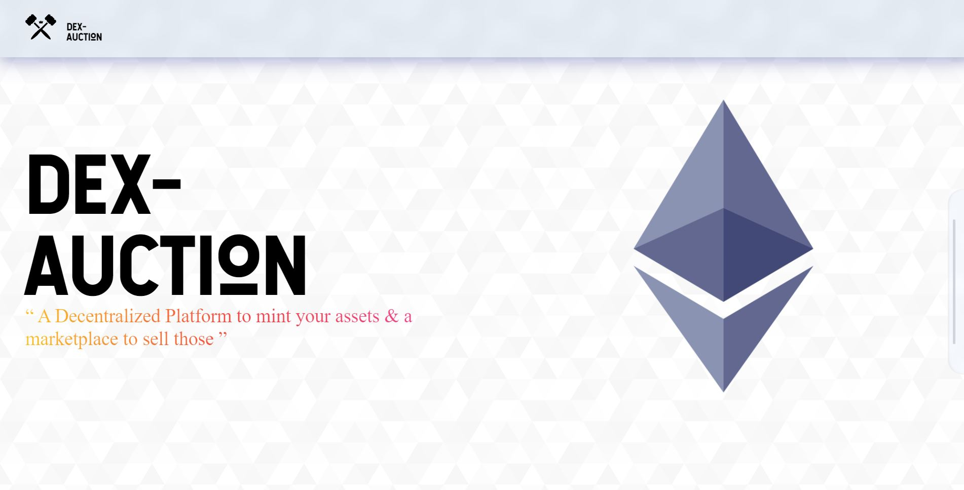
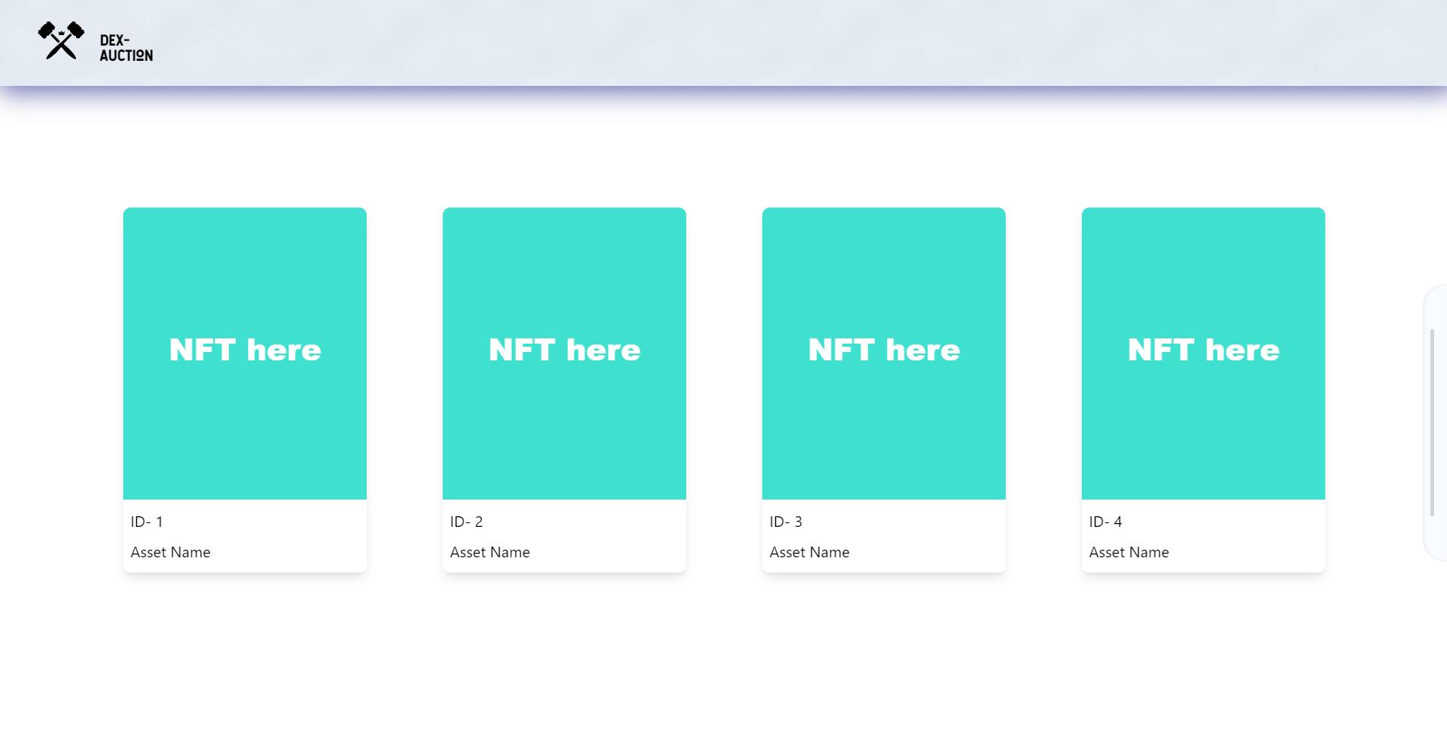
Pages
Landing Page
3
Notes:
https://unsplash.com/photos/48nerZQCHgo

Slide 7
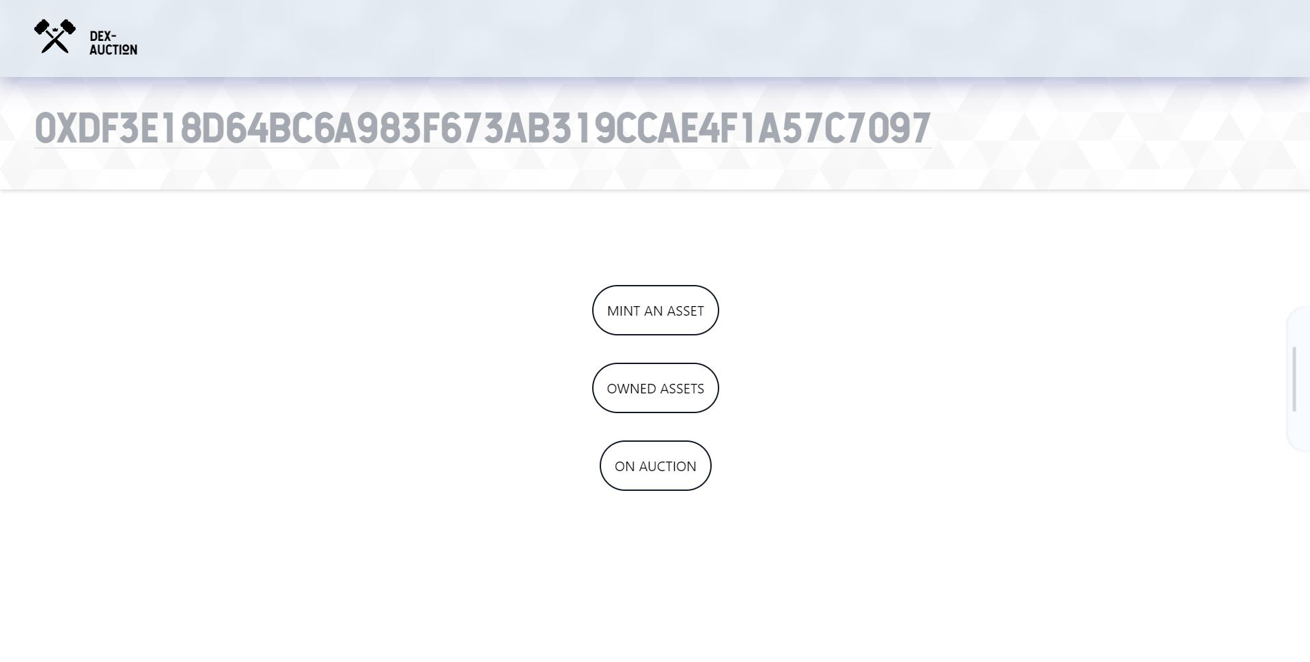
MyAsset Page
4
Notes:
https://unsplash.com/photos/48nerZQCHgo

Slide 8
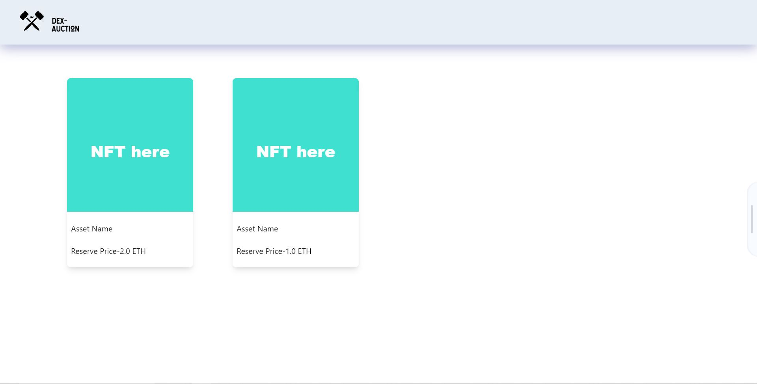
MarketPlace Page
5
Notes:
https://unsplash.com/photos/48nerZQCHgo

Slide 9

Smart
Contract

Slide 10

UML Diagram
6
Notes:
https://unsplash.com/photos/TvN54bnuQg8

Slide 11
Testing
Deployment
√ Deploys
Asset
Mint
√ Mints
√ Can Access Owner/All Assets
Burn
√ Burns
√ Should not burn non-existent NFT
√ Should not burn other's NFT
√ Should not burn NFT which is on auction
Auction
Create
√ Creates Auction
√ Only seller should be able to create Auction
√ Should not create Auction if NFT not approved
√ Should not create Auction when duration is 0 min
√ Should not re-create existing Auction
Bid
√ Accepts Bid
√ Accepts Max Bid
√ Refunds Prev Bidder Bid
√ Not accepts low Bid
√ Should not accept bid when auction over but not claimed
Claim
√ Claims when auction successful
√ Should not be able to claim before Auction is finished
√ Should restrict Claim only to the winner
√ Seller should be able to claim back if winner didn't claim
√ Seller should not be able to claim if Claiming Period is not over
Cancel
√ Cancels Auction
√ Refunds Bid when cancelled
√ Returns NFT to seller when Auction cancelled
Administrative
√ Only CEO Should be able to set new CEO
√ Only CEO Should be able to set new CFO
√ Only Chiefs should be able to Pause Contract
√ When Paused no functionality should work
√ Only CEO should be able to Unpause Contract
Real World Simulation
√ Works Properly in real world conditions
7
Notes:
https://unsplash.com/photos/TvN54bnuQg8

Slide 12

To-Do

Slide 13
Things To Do
Fix error handling in Marketplace.
Setting up IPFS.
Integrating IPFS in front-end.
Hosting local IPFS connection.
Setting up Axios in front-end.
Adding IPFS fetch using Axios in front-end.
Adding file upload and viewing feature in front-end.
8
Notes:
https://unsplash.com/photos/48nerZQCHgo

